Slide 1
Unit 7 Topics 7.1 – 7.14: Equilibrium
A+ College Ready
November 14, 2020 and January 28, 2021
Dr. John Gelder (Emeritius)
Department of Chemistry
Oklahoma State University
Lisa McGaw (Emeritus)
AP Chemistry Teacher (Texas),
2-year College (Oklahoma)
And 4-year University (Oklahoma)
Notes:
Use this to introduce a concept/topic.

Slide 2
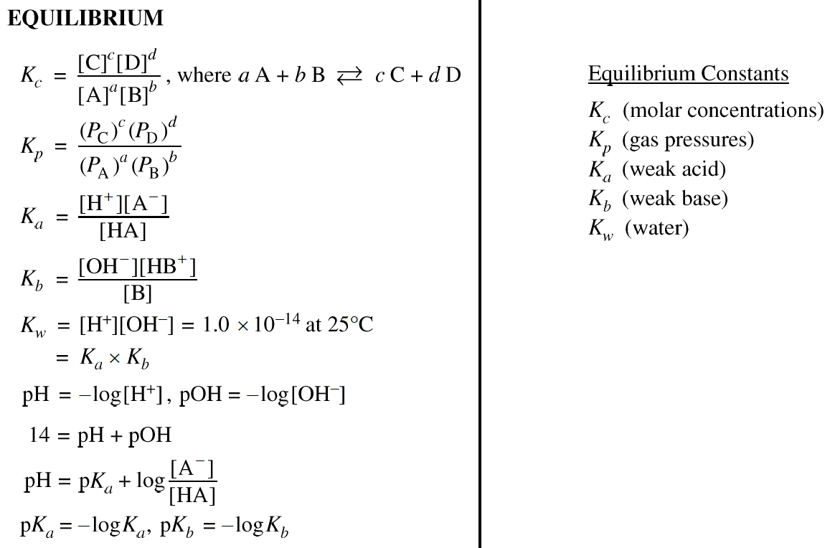
Equations and Constants
College Board Equation Sheet
Notes:
Use this to introduce a concept/topic.

Slide 3

EQUATIONS NOT FOUND ON THE AP EQUATION SHEET
Equilibrium –
K_{sp} = [A⁺] [B⁻] where AB(s) $⇄$ A⁺ (aq) + B⁻(aq)
Notes:
Use this to introduce a concept/topic.

Slide 4
Asynchronous Work…BCEs, DCIs and ACAs for Equilibrium
BDA Teacher Web site: Equilibrium is Unit 10
http://genchem1.chem.okstate.edu/BDA/Topics.php
BCE | DCI | ACA
BCE49 | DCI49 | ACA55 | BCE: Intro to reversible Rxn. ACA: Reversible reactions | Data (Java & video) BCE, ACA
BCE50 | DCI50 | ACA56 | BCE: Macroscopic reversible rxn ACA: using ICE tables to determine K
BCE51 | DCI51 | ACA57 | BCE: Using ICE tables to calculate []_{eq}. ACA: ICE table practice
BCE52 | DCI52 | ACA58 | BCE: ICE table practice. ACA: ICE table practice.
BCE79 | DCI78 | ACA78 | BCE and ACA: Le Chatelier’s Principle. | Make video’s
Notes:
Use this to introduce a concept/topic.

Slide 5
Thinking about an introduction to Chemical Equilibrium
Lecture notes on equilibrium constants
Practice calculating equilibrium constants
Practice calculating concentrations of reactants and products at equilibrium
Le Chatelier’s Principle Comparing Q (nonequilibrium reaction quotient) to K.

Slide 6
2018 and 2019 AP Chemistry Exam
Question 2
2019 AP Chemistry Exam Question 2 parts d, e and f
Rubric
Chief Reader Report
2018 AP Chemistry Exam Question 2 parts b and c
Rubric
Chief Reader Report

Slide 7
2019 AP Chemistry Exam
Question 2
The compound BrCl can decompose into Br₂ and Cl₂, as represented by the balance chemical equation below.
2BrCl(g) $⇄$ Br₂(g) + Cl₂(g) ∆H˚ = 1.6 kJ/mol_{rxn}
A 0.100 mol sample of pure BrCl(g) is placed in a previously evacuated, rigid 2.00 L container at 298 K. Eventually the system reaches equilibrium according to the equation above.
(d) Calculate the pressure in the container before equilibrium is established.
(e) Write the expression for the equilibrium constant, Keq, for the decomposition of BrCl.
After the system has reached equilibrium, 42 percent of the original BrCl sample has decomposed.
(f) Determine the value of Keq for the decomposition reaction of BrCl at 298 K.

Slide 8
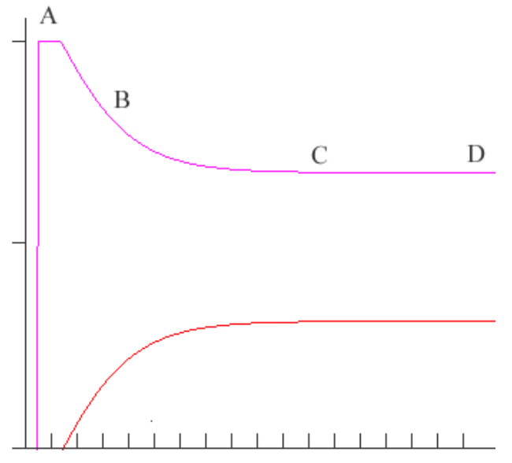
Thinking about an equilibrium problems
In the graph below the endothermic reaction
BR(g) $⇄$B(g) +R(g)
is represented. Initially only BR(g) is present in the reaction vessel. The marks along the x-axis are in 1 minute increments. The initial [BR] (y-axis) is 2.0 M. The reaction begins about 1.5 minutes in this case.
At what point (indicate a
letter) does the reaction attain
equilibrium?
(b) Indicate whether K for the
reaction is greater than 1, less
than 1 or equal to 1. Explain.
(c) At point ‘B’ indicate how Q
compares to K. Explain.

Slide 9
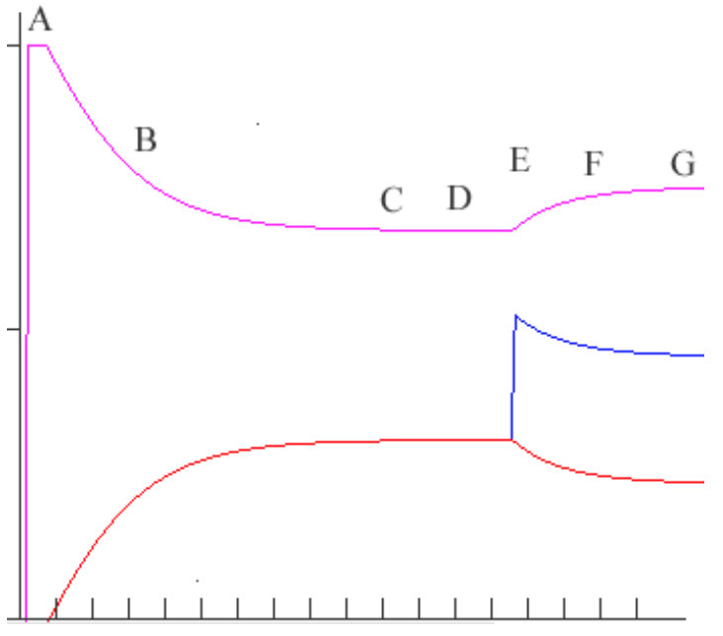
Thinking about an equilibrium problems
In the graph below the endothermic reaction
BR(g) $⇄$B(g) +R(g)
is represented. Initially only BR(g) is present in the reaction vessel. The marks along the x-axis are in 1 minute increments. The initial [BR] (y-axis) is 2.0 M. The reaction begins about 1.5 minutes in this case.
(d) In this new view the same reaction has occurred. Indicate the stress (at point E) that was imposed on the system, and explain how the system changed as a response to the stress.

Slide 10
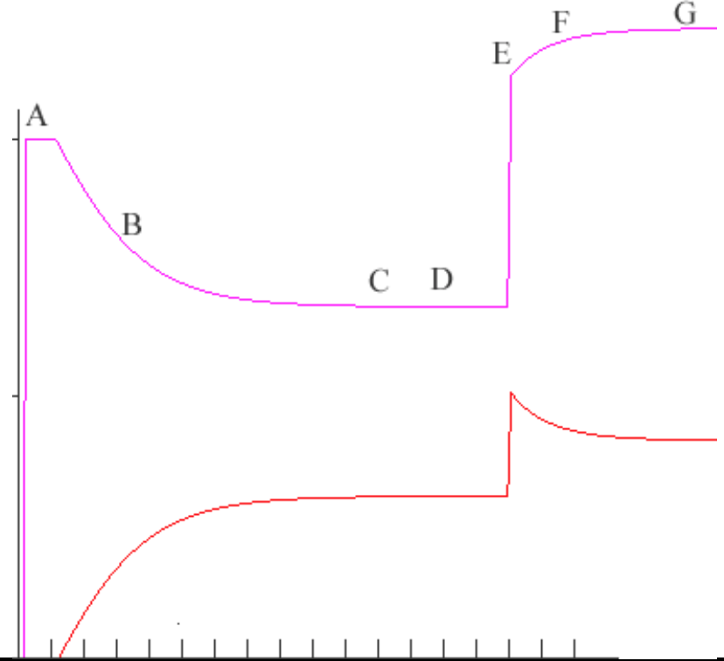
Thinking about an equilibrium problems
In the graph below the endothermic reaction
BR(g) $⇄$B(g) +R(g)
is represented. Initially only BR(g) is present in the reaction vessel. The marks along the x-axis are in 1 minute increments. The initial [BR] (y-axis) is 2.0 M. The reaction begins about 1.5 minutes in this case.
(e) In this new view the same reaction has occurred. Indicate the stress (at point E) that was imposed on the system, and explain how the system changed as a response to the stress.

Slide 11
QUESTIONS?
Talk/chat to John Gelder
or
john.gelder@okstate.edu

Slide 12
Thinking about an introduction to Chemical Equilibrium
Introducing reversible and irreversible reactions using a particulate level followed by a macroscopic approach approach.
Inquiry Activity
Particulate level (.jnlp file)
Particulate level (video)
Macroscopic level
Getting students to invent Le Chatelier’s Principle
Guided Inquiry Activity
Following a reversible reaction with chart recordings (.jnlp file)
Following a reversible reaction with chart recordings (video)
Inventing the Equilibrium Constant
Guided Inquiry Activity
Chart Recording (.jnlp file)
Chart Recording (video files….not prepared yet)
Lecture notes on equilibrium constants
Practice calculating equilibrium constants
Practice calculating concentrations of reactants and products at equilibrium

